Slide 1
BUSY CART – Online shopping portal
Meghna Sharma

Slide 2
Objective of the project
ONLINE SHOPPING is the process whereby customers directly buy goods, services etc. from a seller interactively in real- time without an intermediary service over the internet. The goal of this application is to develop a web based interface for online retailers and consumers. The system would be easy to use and hence make the shopping experience pleasant for the users.
Goal of this project-
The user can easily add a product to or remove a product from the shopping cart.
An admin can view the review or feedback of the user along with other details.

Slide 3
Advantages
Choose goods that are simpler and smoother in one place.
Saving time to travel to the vendor.
Alerts and real-time email access.
The developed reports can be preserved for future reference purposes.

Slide 4
Disadvantages
It is difficult to maintain important information in books.
More manual hours need to generate required reports.
It is tedious to manage historical data.
Difficult to maintain daily sales and purchases.

Slide 5
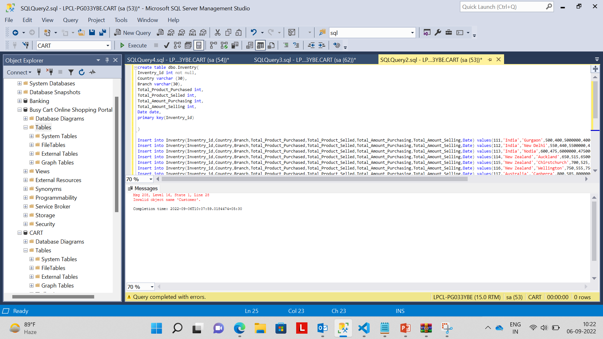
Inventry COMMAND

Slide 6
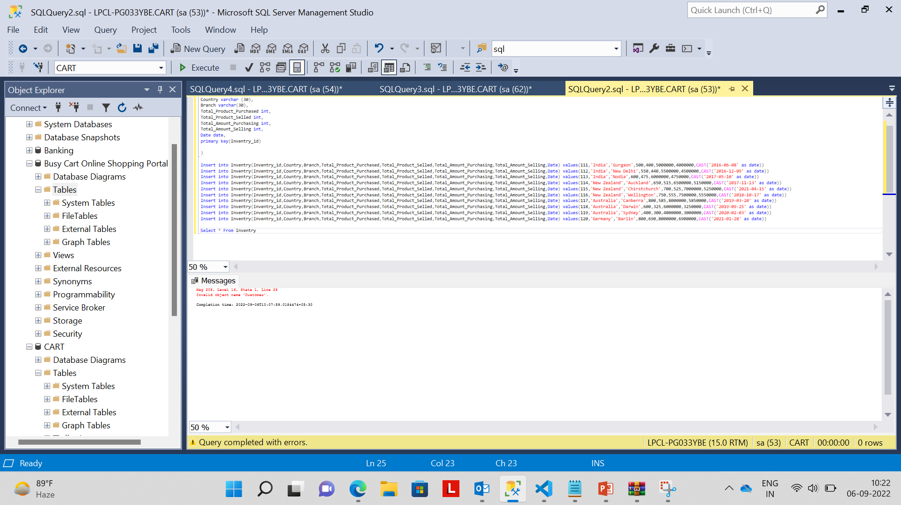
INVENTRY INSERTION

Slide 7
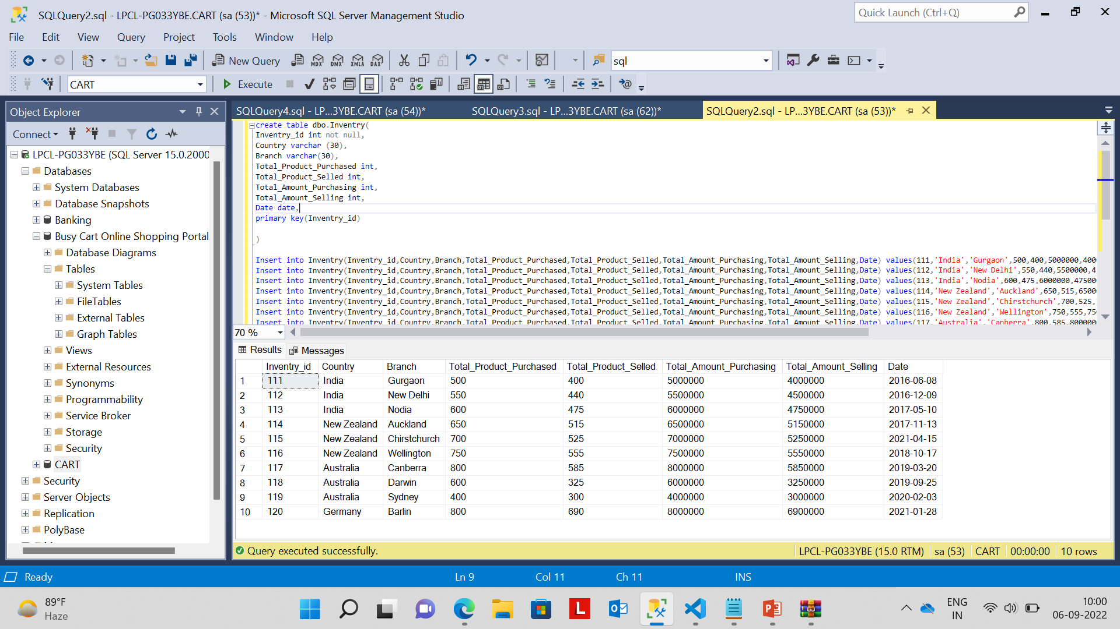
Inventry TABLE

Slide 8
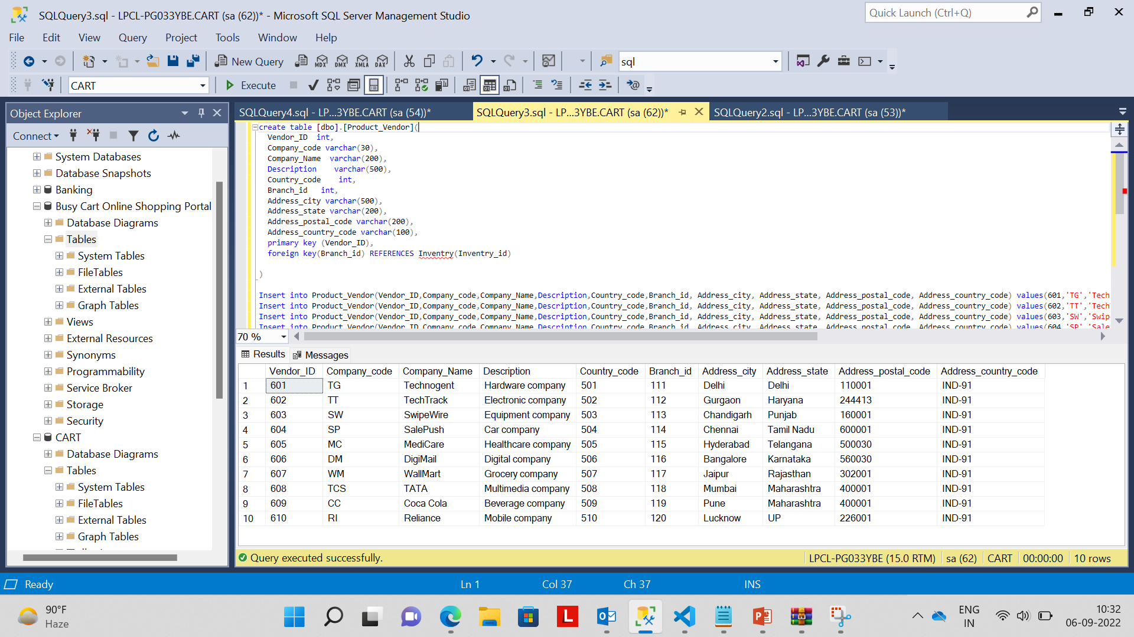
VENDOR COMMAND

Slide 9
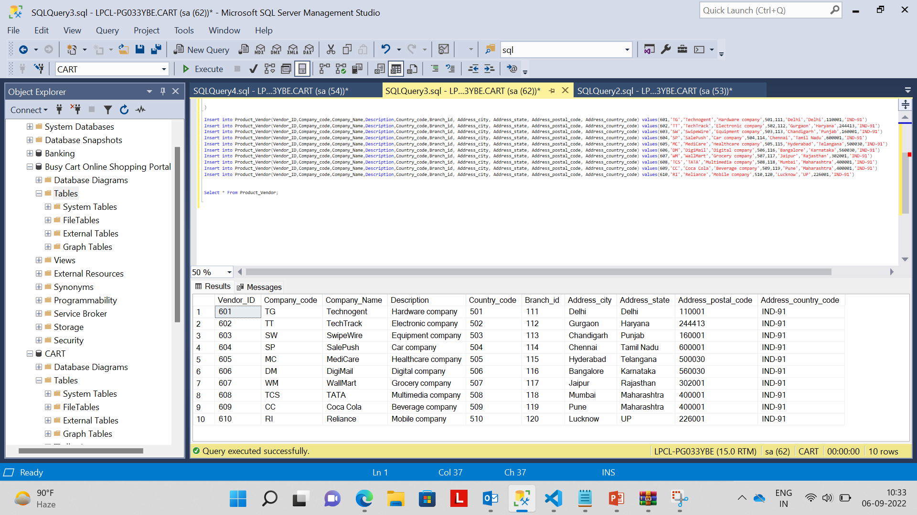
VENDOR INSERTION

Slide 10
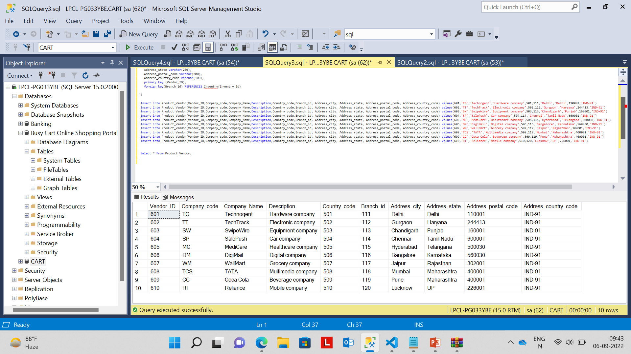
Vendor

Slide 11
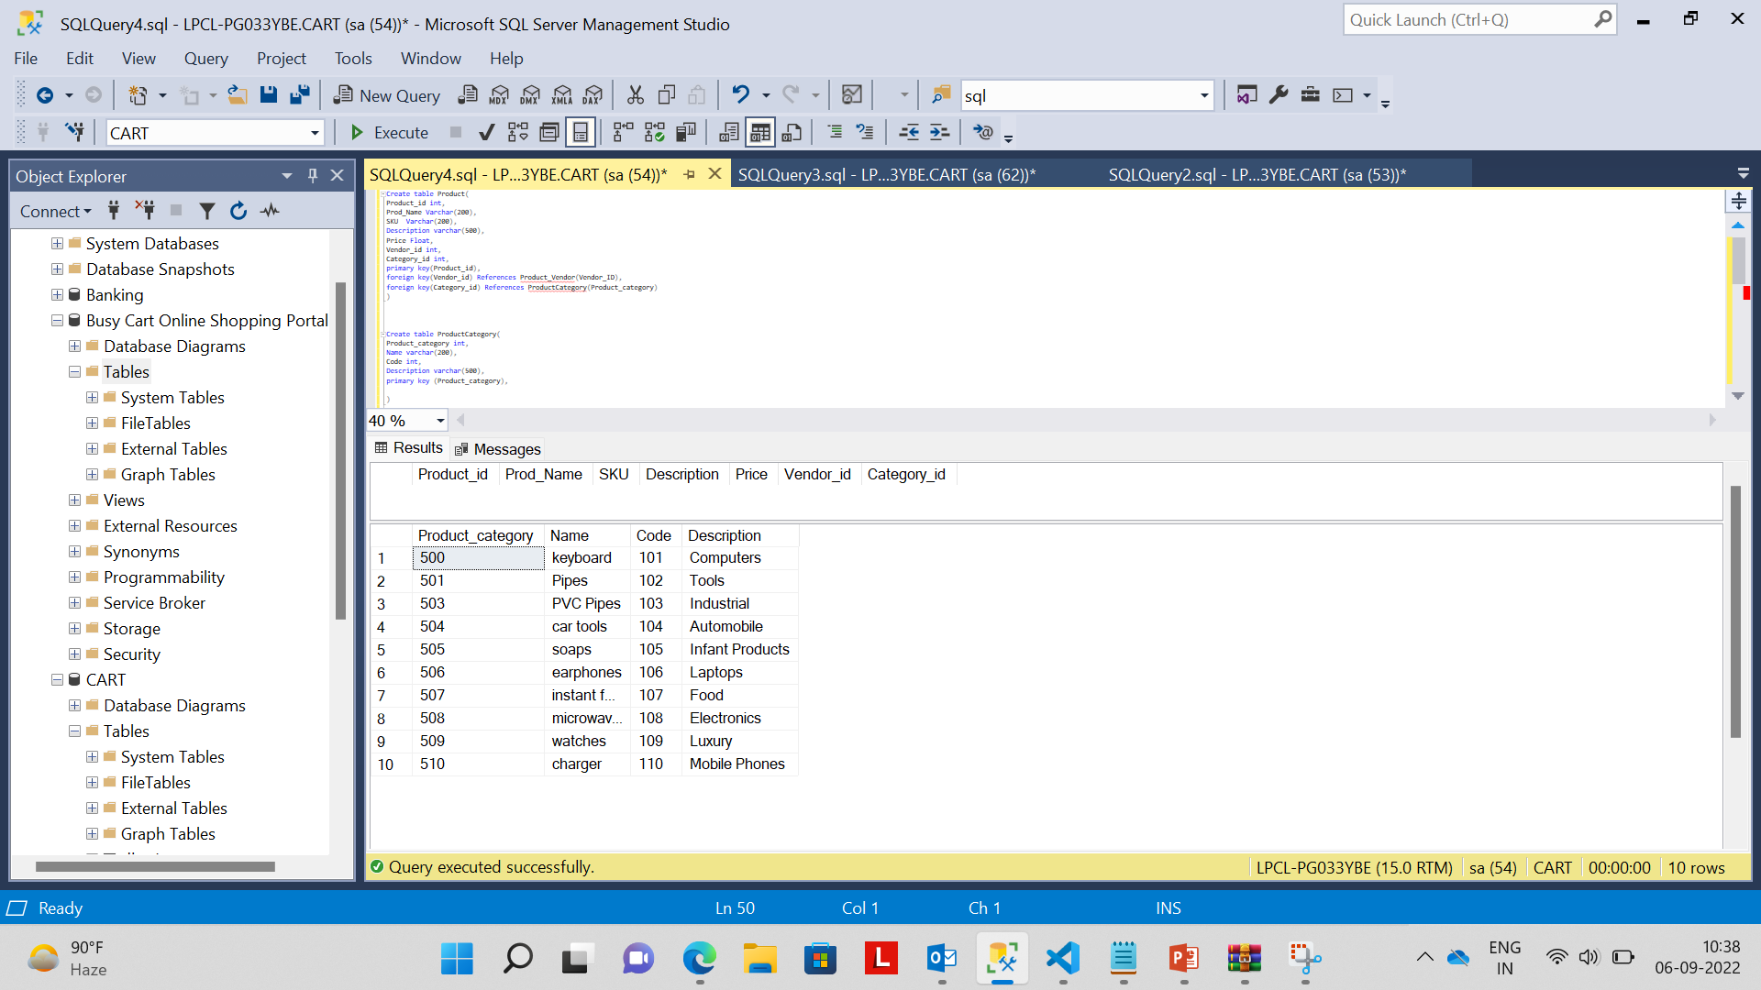
PRODUCT COMMAND

Slide 12
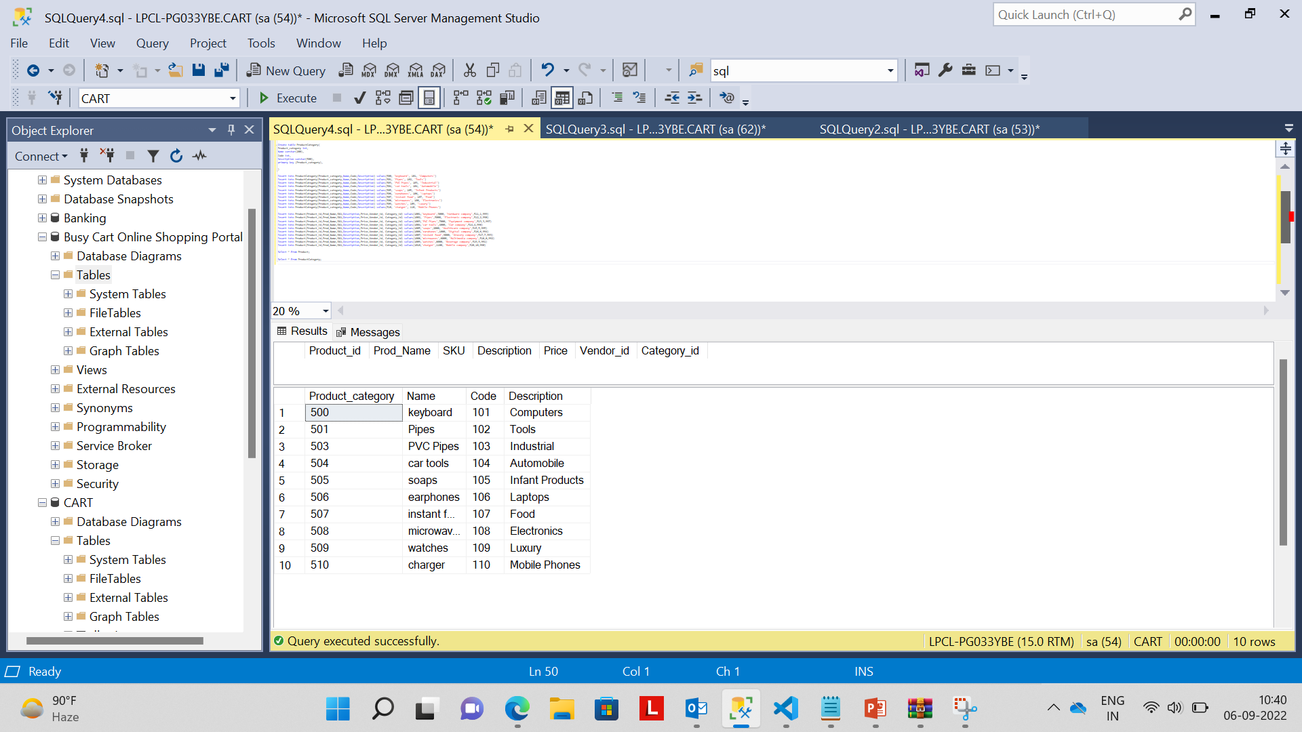
PRODUCT INSERTION

Slide 13
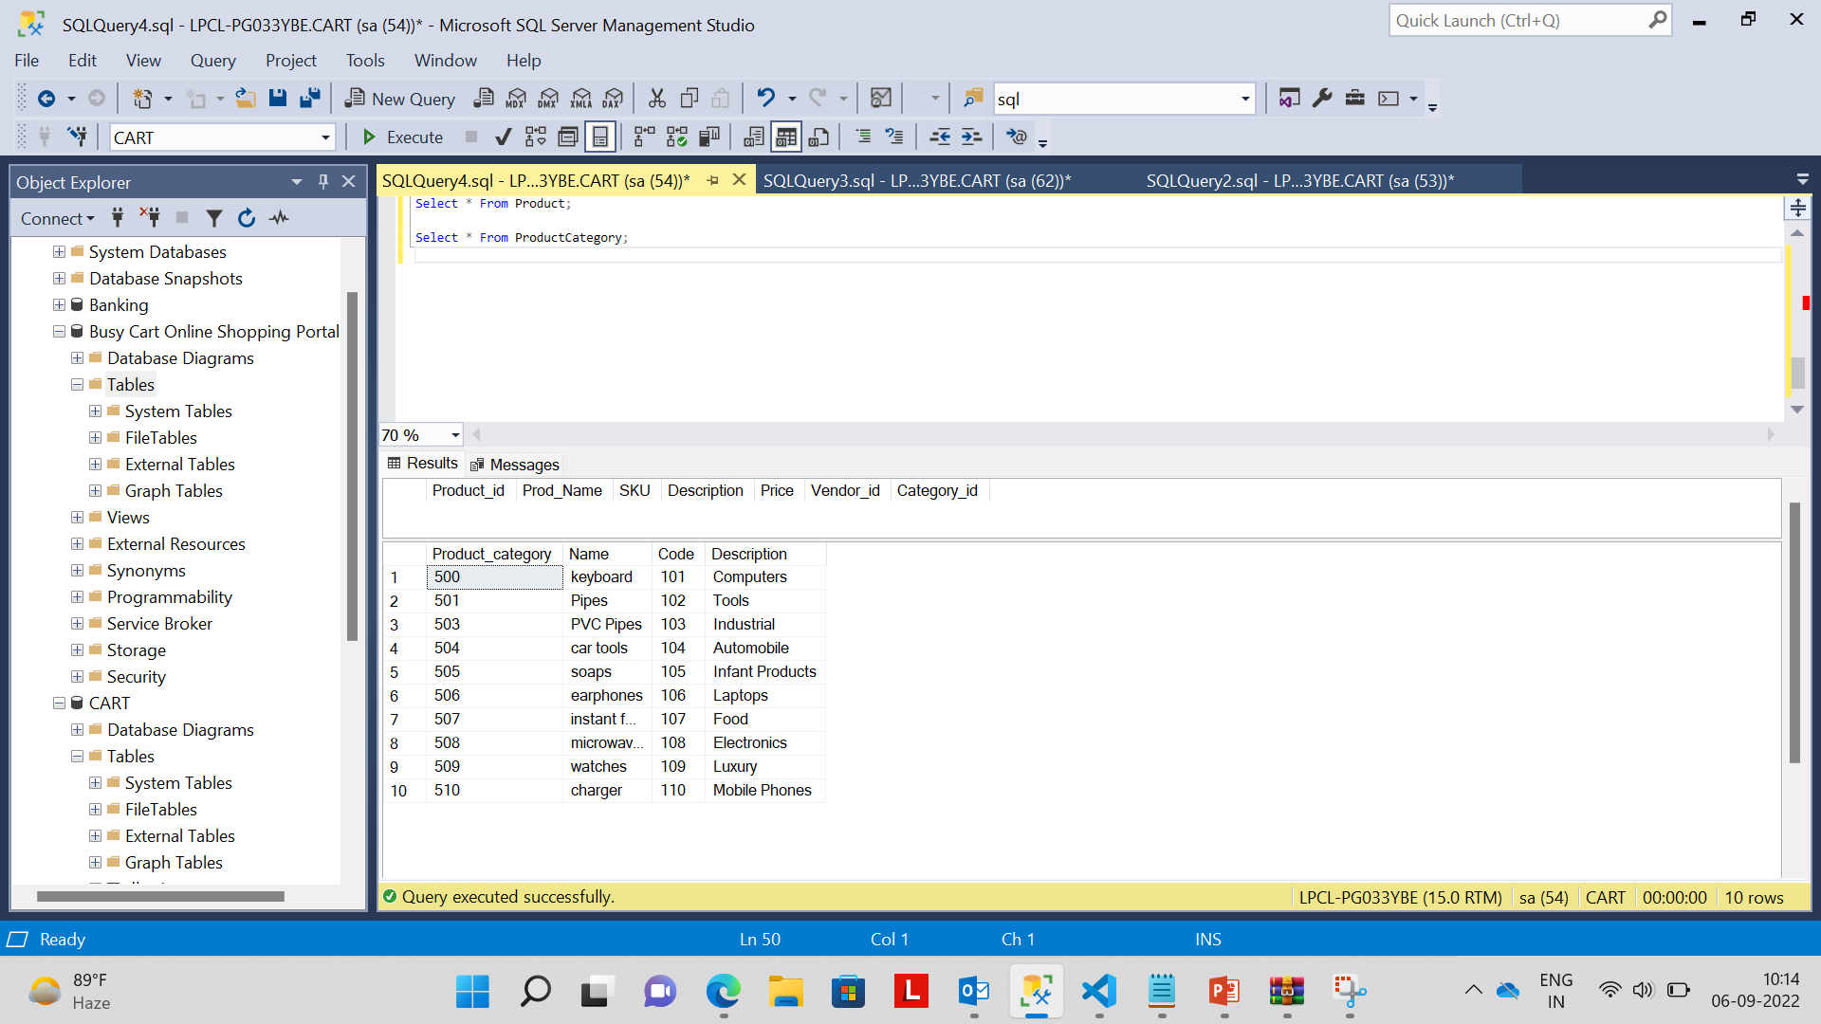
Product

Slide 14
CONCLUSION
Shopping Cart System project shopping cart system has successfully provides customers a real shop. This project is to make this users purchase items online. A complete and efficient web application which can provide by our application.

